Slide 1
DUMB WAYS TO PIE
Why is it trendy to hate on pie charts?

Slide 2
DUMB WAYS TO PIE
Why is it trendy to hate on pie charts?

Slide 3
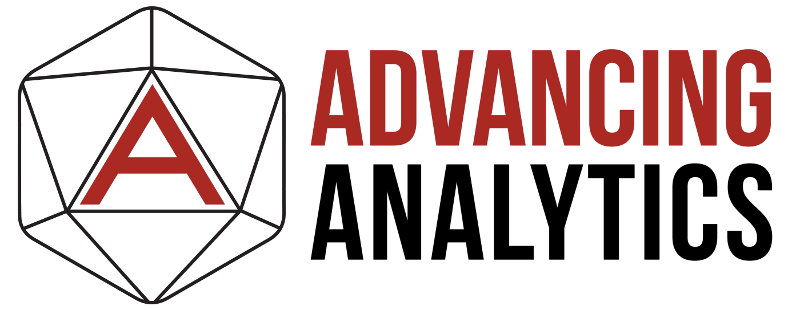



ABOUT JOHNNY (He/HIM)

Slide 4






ABOUT JOHNNY (He/HIM)

Slide 5
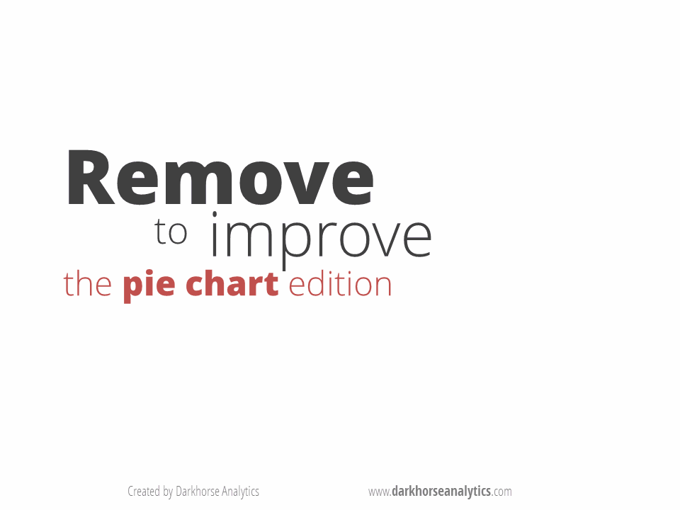
HOW TO MAKE AN EFFECTIVE PIE CHART…

Slide 6
THE HUMAN BRAIN IS TERRIBLE AT JUDGING SIZE IN SLICES…
Notes:
For the technologies we work with, the modelling method that we recommend at Greyskull Analytics is a Star Schema.​
​

Slide 7
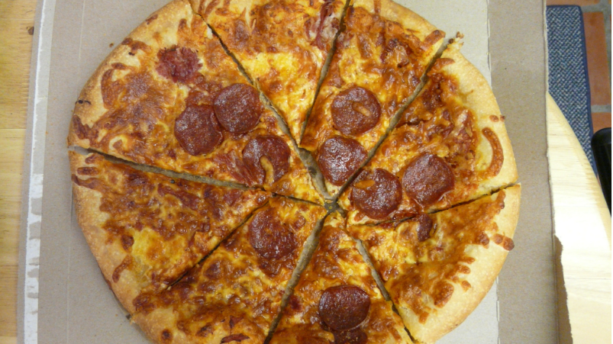

Slide 8
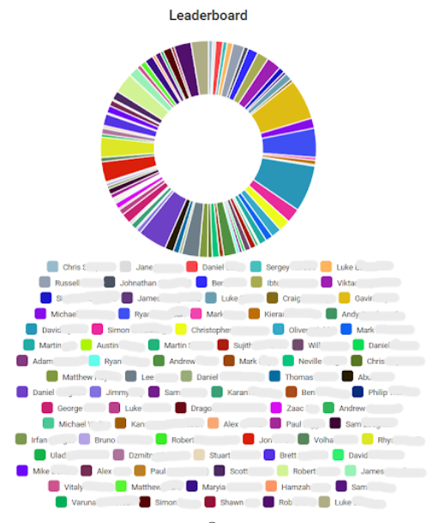
CRIMES AGAINST PIE CHARTS…

Slide 9
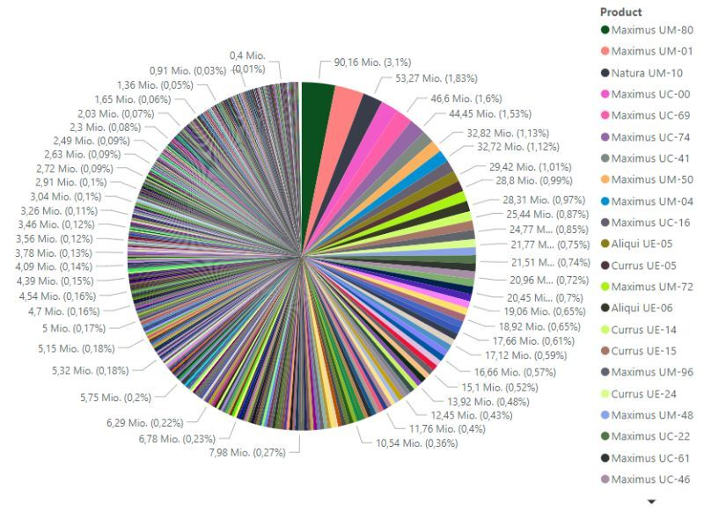
CRIMES AGAINST PIE CHARTS…
Source: https://www.linkedin.com/posts/k-borchert_powerbi-charts-piecarts-activity-7302953558826532865-lHuj

Slide 10
BUT 4 to 5 slices is ok, right?
Notes:
For the technologies we work with, the modelling method that we recommend at Greyskull Analytics is a Star Schema.​
​

Slide 11
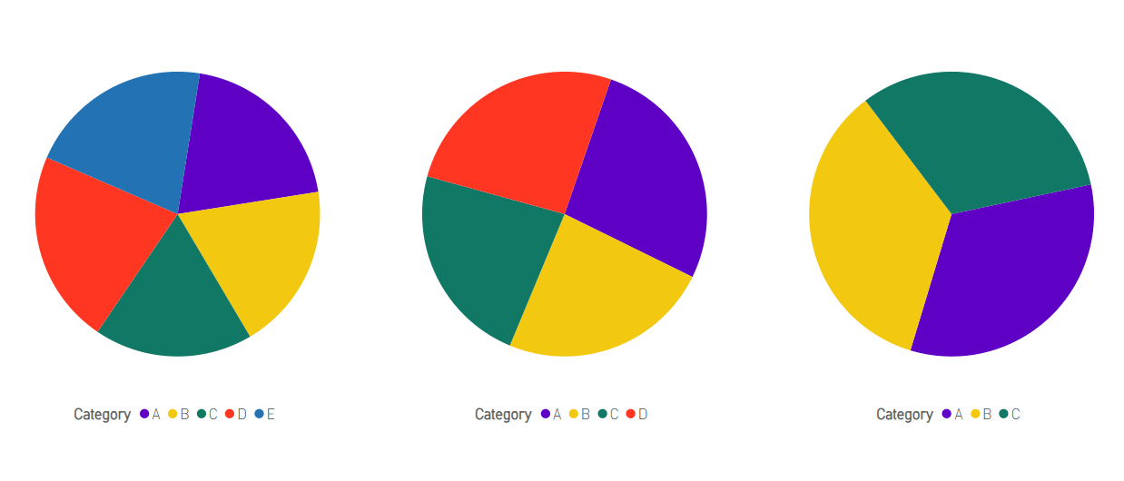
WHICH SLICE IS BIGGEST?
Notes:
The problem we face is the disconnect between the developments teams, who are responsible for building the data model and the business users and analysts who will actually use the data platform for doing their analysis.​
​
I've worked with some great developers across many industries who understand the technology and are good are writing code, but often lack the domain knowledge to make sure the data model they develop will meet their users needs.​
​
I've also worked along side end users who understand the way the business operates and know what they want, but find it difficult to communicate this to developers in a way that makes it easy for them to go away and implement this.​

Slide 12
WHICH SLICE IS BIGGEST?
21%
26%
32%
20%
27%
22%
35%
19%
23%
33%
24%
18%
Notes:
The problem we face is the disconnect between the developments teams, who are responsible for building the data model and the business users and analysts who will actually use the data platform for doing their analysis.​
​
I've worked with some great developers across many industries who understand the technology and are good are writing code, but often lack the domain knowledge to make sure the data model they develop will meet their users needs.​
​
I've also worked along side end users who understand the way the business operates and know what they want, but find it difficult to communicate this to developers in a way that makes it easy for them to go away and implement this.​

Slide 13
WHICH SLICE IS BIGGEST?
21%
26%
32%
20%
27%
22%
35%
19%
23%
33%
24%
18%
Notes:
The problem we face is the disconnect between the developments teams, who are responsible for building the data model and the business users and analysts who will actually use the data platform for doing their analysis.​
​
I've worked with some great developers across many industries who understand the technology and are good are writing code, but often lack the domain knowledge to make sure the data model they develop will meet their users needs.​
​
I've also worked along side end users who understand the way the business operates and know what they want, but find it difficult to communicate this to developers in a way that makes it easy for them to go away and implement this.​

Slide 14
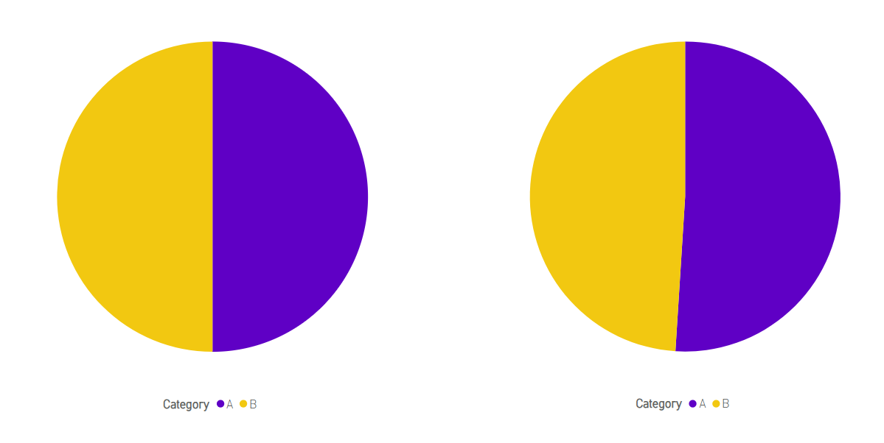
WHICH SLICE IS BIGGEST?
21%
18%
Notes:
The problem we face is the disconnect between the developments teams, who are responsible for building the data model and the business users and analysts who will actually use the data platform for doing their analysis.​
​
I've worked with some great developers across many industries who understand the technology and are good are writing code, but often lack the domain knowledge to make sure the data model they develop will meet their users needs.​
​
I've also worked along side end users who understand the way the business operates and know what they want, but find it difficult to communicate this to developers in a way that makes it easy for them to go away and implement this.​

Slide 15
WHICH SLICE IS BIGGEST?
50%
50%
49%
51%
Notes:
The problem we face is the disconnect between the developments teams, who are responsible for building the data model and the business users and analysts who will actually use the data platform for doing their analysis.​
​
I've worked with some great developers across many industries who understand the technology and are good are writing code, but often lack the domain knowledge to make sure the data model they develop will meet their users needs.​
​
I've also worked along side end users who understand the way the business operates and know what they want, but find it difficult to communicate this to developers in a way that makes it easy for them to go away and implement this.​

Slide 16
SO, SHOULD I USE A PIE CHART?
Notes:
For the technologies we work with, the modelling method that we recommend at Greyskull Analytics is a Star Schema.​
​

Slide 17
GOLDEN RULES FOR PIE CHARTs…
First rule of pie charts
1. We don’t talk about pie charts

Slide 18
GOLDEN RULES FOR PIE CHARTs…
No more than 2 data series
Largest slice should always start from 12 o’clock

Slide 19
GOT ANY GOOD EXAMPLES?
Notes:
For the technologies we work with, the modelling method that we recommend at Greyskull Analytics is a Star Schema.​
​

Slide 20
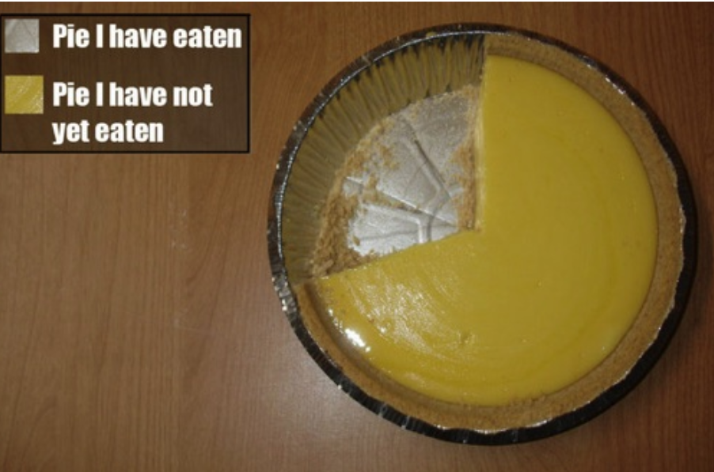

Slide 21
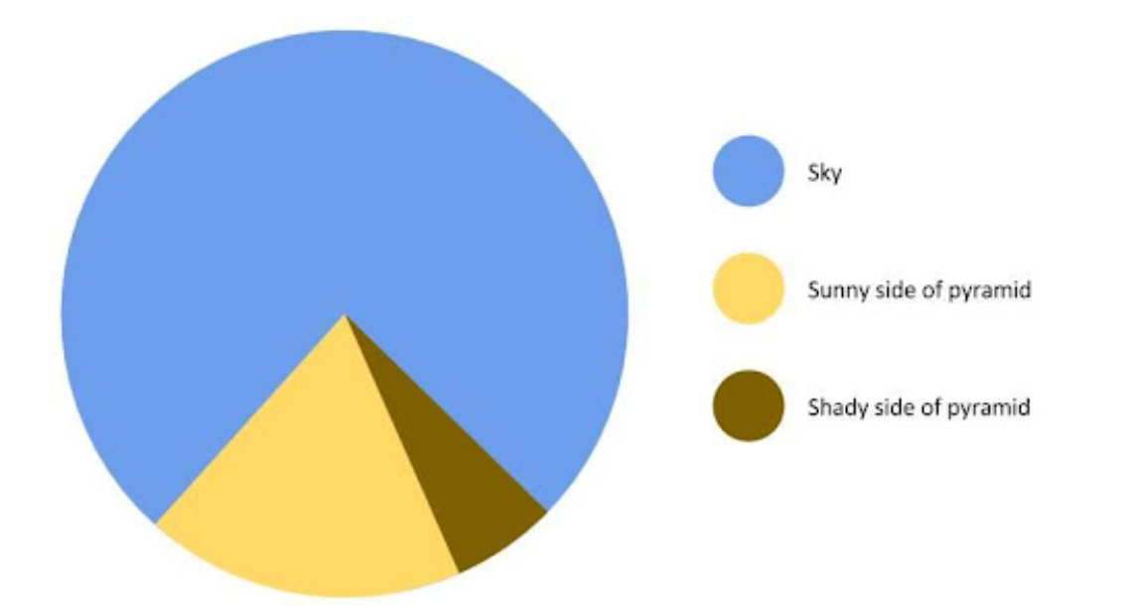

Slide 22
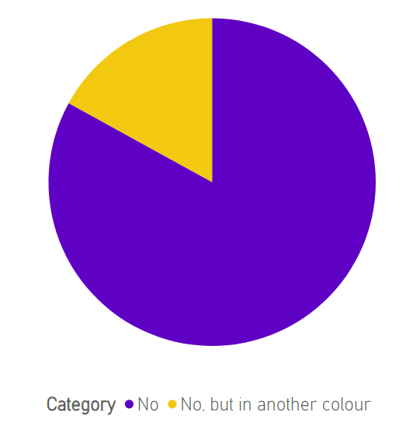
ARE PIE CHARTS INHERENTLY BAD?

Slide 23
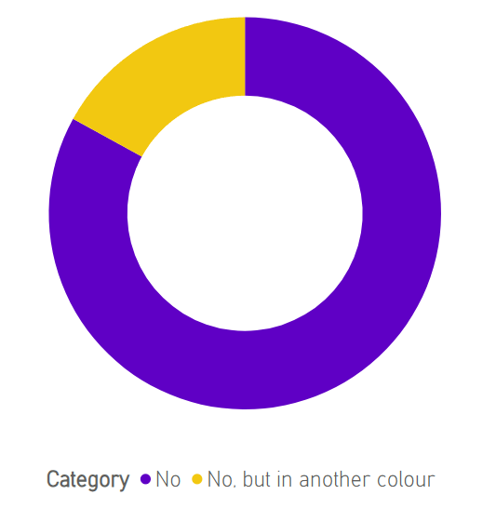
ARE PIE CHARTS INHERENTLY BAD?

Slide 24

WHAT % OF PEOPLE AGREE PIE CHARTS aRE NOT INHERENTLY BAD?
83%

Slide 25
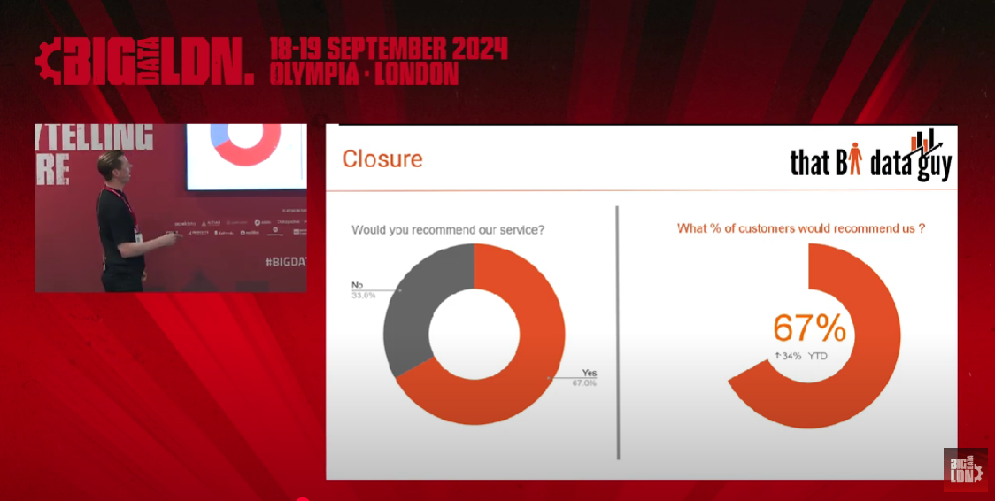

Slide 26

PIE CHART RESPONSIBLY!

Slide 27

MAKE PIE CHARTS GREAT AGAIN!

Slide 28
THANK YOU!
LinkedIn - https://www.linkedin.com/in/j0hnnyw1nter/
BlueSky - @greyskullpbi.bsky.social
Website – https://greyskullanalytics.com/
SubStack – https://greyskullanalytics.substack.com/
Github - https://github.com/GreyskullAnalytics

Slide 29

THANK YOU!

